Slide 1
Image Transformations
Concept, Requirement, Types , Tools, Applications
Computer Vision, 6th Semester, 2024

Slide 2
Image Transforms
An image transform can be applied to an image to convert it from one domain to another.
Viewing an image in domains such as frequency or Hough space enables the identification of features that may not be as easily detected in the spatial domain.
Other applications:
Compression
Filtering
Warping/morphing

Slide 3
Types and Applications
Spatial-to-Frequency transforms:
Hough Transform
used to find lines in an image
Discrete Cosine Transform
used in image and video compression
Discrete Fourier Transform
used in filtering and frequency analysis
Haar Wavelet Transform
used to perform discrete wavelet analysis, denoise, and fuse images
Karheunen—Loeve Transform
Walsh Transform
Hadamaard Transform
Radon Transform, etc.
Other transforms:
Distance Transform
Parametric Transform
Mesh-based Warping

Slide 4
Features highlighted
Distance Transform:
the thickness of image features
Fourier Transform:
the spatial frequency composition of the image
Hough Transform
the parameters of geometric shapes.

Slide 5
Distance Transform
Using distance metrics to depict binary image as distance coefficients
Each foreground pixel (1) is shown as the nearest distance from neighbouring background pixels (0).
Distance metrics are used:
Euclidean distance: square root of sum of squares of x and y differences
Manhattan/City-block distance: sum of absolutes of x and y differences
Chessboard distances: maximum of absolutes of x and y distances
Other:
Chebyshev Distance
Cosine Similarity
Hamming Distance
Minkowski Distance
Mahalanobis Distance
Earth Mover's Distance (Wasserstein Distance)

Slide 6
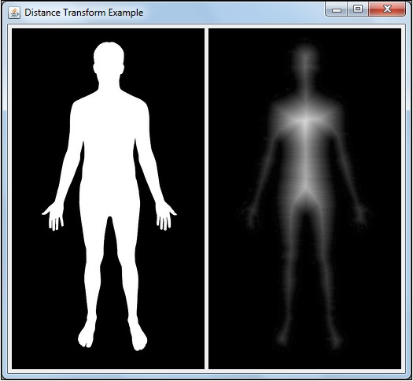
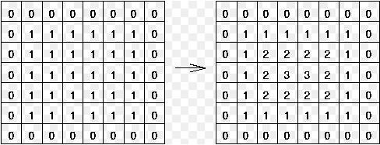
Distance Transform

Slide 7
Distance Transform – Merits and Demerits
Merits
Demerits
Shape Analysis
Skeletonization
Image Segmentation
Medial Axis Extraction
Simplicity in:
Object Recognition
Image Registration
Computationally Intensive
Sensitivity to Noise
Discretization Effects
Limited to Binary Images
Directionality
Parameter Sensitivity
Boundary Artifacts

Slide 8
Discrete Fourier Transform
Used to analyze the frequency content of images
Transforms an image from its spatial domain (pixel values) to its frequency domain
Reveals information about the variation in intensity and spatial frequencies present in the image

Slide 9
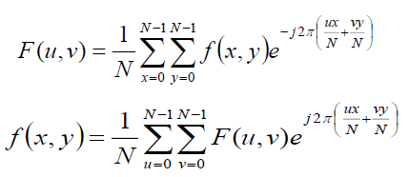
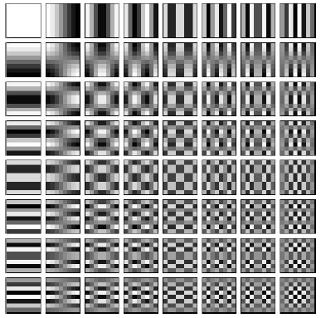
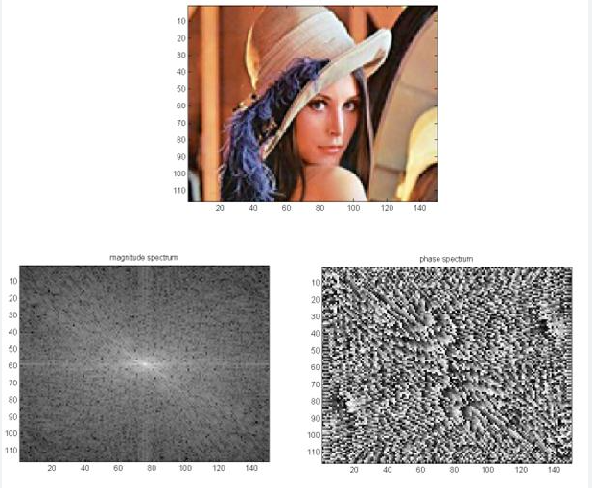
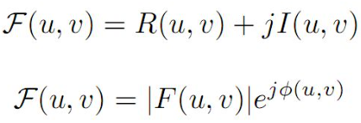
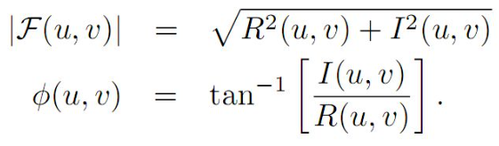
Discrete Fourier Transform
Formula
Basis Images
Example

Slide 10
2d D.f.t. – Utility
Frequency Analysis
Image Filtering
Compression
Feature Extraction
Image Reconstruction
Noise Removal
Pattern Recognition
Fourier Descriptors

Slide 11
2D D.F.T. – Merits and Demerits
Merits
Demerits
Frequency Analysis
Image Filtering
Shift Invariance
Convolution Theorem
Image Reconstruction
Orthogonality
Phase Information
Computational Complexity
Boundary Effects
Loss of Spatial Information
Sensitivity to Noise
Memory Requirements
Limited Directional Information

Slide 12
Discrete Cosine Transform
Similar to DFT
Advantageous in terms of:
Energy compaction
Ability to represent image data in a more compact form
Well-suited for applications of compact representation and efficient coding
Digital image and video compression standards

Slide 13
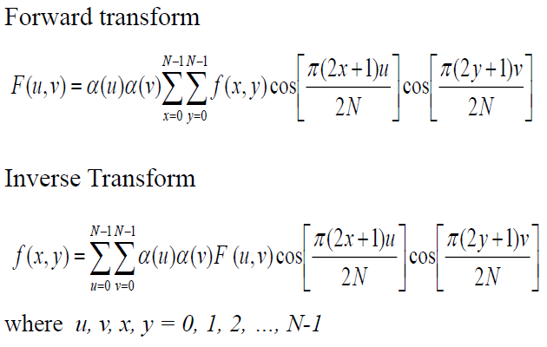
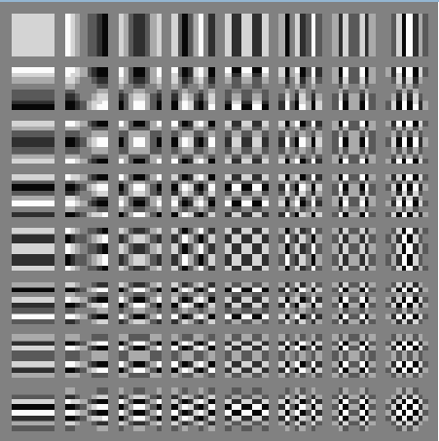
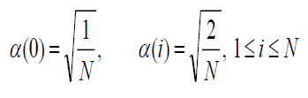
Discrete Cosine Transform
Formula
Basis Images

Slide 14
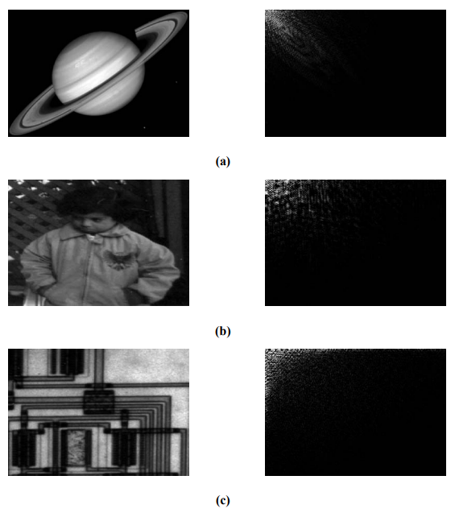
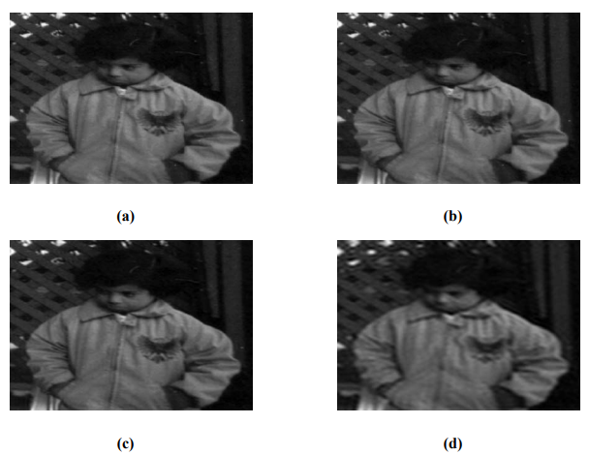
Discrete Cosine Transform
Energy Compaction Property
Reconstruction (Usage in J.P.E.G. Compression)
Inverse DCT(100%)
Inverse DCT(75%)
Inverse DCT(50%)
Inverse DCT(25%)

Slide 15
2D D.C.T. – Utility
Image Compression (JPEG Compression)
Energy Compaction
Image Reconstruction
Feature Extraction
Image and Video Coding
Watermarking and Steganography
Reduction of Blocking Artifacts
Signal Processing Applications

Slide 16
2D D.C.T. – Merits and Demerits
Merits
Demerits
Energy Compaction
Compression Efficiency
Real-Valued Coefficients
Reduction of Blocking Artifacts
Computational Efficiency
Image Reconstruction
Application in Video Compression
Low Sensitivity to Small Perturbations
Limited Spatial Information
Lossy Compression
Boundary Effects
Sensitivity to Block Size
Limited Directional Information

Slide 17
Hough Transform
Used in image processing and computer vision for the detection of shapes, particularly straight lines and circles, in an image
Primary purpose:
Identify instances of simple geometric shapes within an image, even when they are partially obscured, distorted, or incomplete
Most common forms:
Hough Line Transform
Hough Circle Transform

Slide 18
Hough Line Transform
The Hough Line Transform is used for detecting straight lines in an image.
In its basic form, each point (x, y) in the image space corresponds to a sinusoidal curve in the parameter space (Hough space).
The intersection of curves in the Hough space indicates the parameters (slope and intercept) of a line in the image space.
By setting a threshold in the Hough space, one can identify the parameters corresponding to the lines in the image.

Slide 19
Hough Circle Transform
The Hough Circle Transform extends the idea to detect circles in an image.
For each pixel in the edge-detected image, a circle is parameterized by its center coordinates (x, y) and radius (r).
These parameters form a 3D Hough space, and voting is performed for possible circles.
The peaks in the Hough space represent the centers and radii of the detected circles.

Slide 20
General Steps of Hough Transform
Edge Detection:
Compute the edges in the image using appropriate edge detection algorithms (usually Canny).
Hough Accumulator Space:
Create an accumulator space (Hough space) to represent the parameter space for the shapes being detected.
Each point in the image contributes to curves or surfaces in this space.
Voting:
For each edge point in the image, contribute to the corresponding curves or surfaces in the Hough space.
Peak Detection:
Identify peaks in the Hough space, which correspond to the parameters of the detected shapes.
Thresholding:
Apply a threshold to the peaks to determine the most significant shapes.

Slide 21
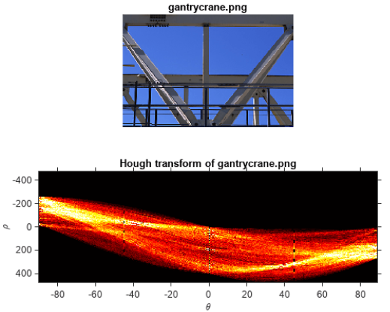
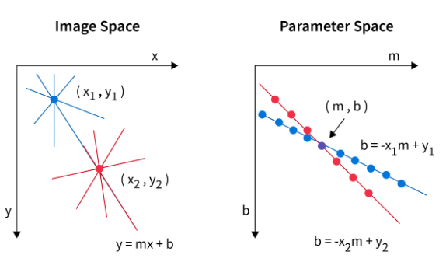
Hough Transform Algorithm
Extract edges of the image
Initialize parameter space r’s, theta’s
Create accumulator array and initialize to zero
For each edge pixel
For each theta
Calculate r = x cos(theta) + y sin(theta)
Increment accumulator at r, theta
Find Maximum values in accumulator (lines)
Extract related r, theta
rho = distance from the origin to the line along a vector perpendicular to the line
theta = angle in degrees between the x-axis and this vector

Slide 22
Hough Transform – Merits and Demerits
Merits
Demerits
Robustness to Noise
Generalization to Arbitrary Shapes
Tolerant to Partial Occlusion
Invariance to Rotation
Useful for Feature Extraction
Applications in Computer Vision
Computational Complexity
Accumulator Space Resolution
Sensitivity to Parameter Settings
Limited to Parametric Representations
Limited for Dense or Continuous Shapes
Memory Requirements

Slide 23
Wavelet Transform
Analyzing and representing images in terms of localized frequency components
Multi-resolution analysis
Detailed representation of both high and low-frequency components within an image
Wavelets:
Mathematical functions localized in both time and frequency domains
Represent signals or images with better time and frequency localization compared to other transforms like Fourier

Slide 24
Wavelet Transform – key concepts
Image Decomposition and Multiresolution Analysis:
Wavelet transforms decompose an image into different levels or scales, applying a series of filters successively.
It reveals details at various resolutions.
Different scales of details in an image can be captured separately.
Two Components:
Wavelet transforms typically produce two sets of coefficients, obtained at different decomposition levels :
Approximation coefficients (representing low-frequency components)
Detail coefficients (representing high-frequency components).
Image Compression:
The decomposition into approximation and detail coefficients allows for efficient coding.
Certain coefficients with lower magnitude can be discarded without significant loss of image quality.
Feature Extraction:
The coefficients obtained at different scales can capture important structural information, making them valuable for computer vision tasks.
Denoising and Image Enhancement:
By thresholding or manipulating the detail coefficients, noise can be reduced while preserving and/or enhancing important image features.

Slide 25
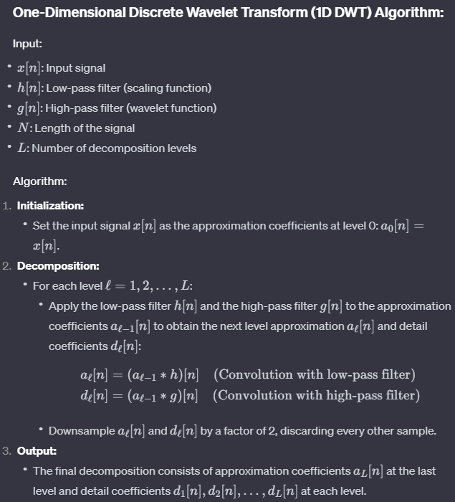
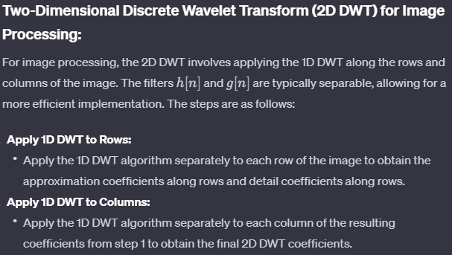
Discrete Wavelet Transform - Algorithm
1D-DWT
2D-DWT

Slide 26
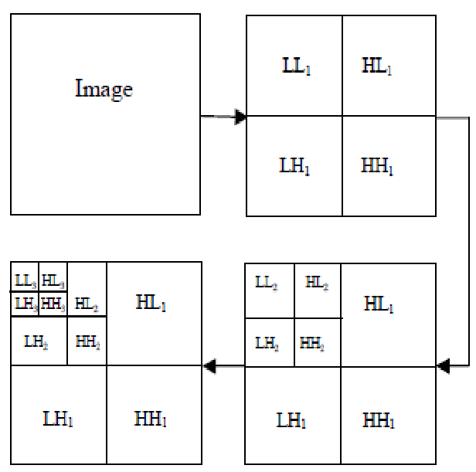
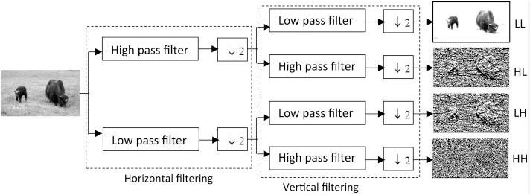
2D-DWT – Process
Filtering process
Decomposition

Slide 27
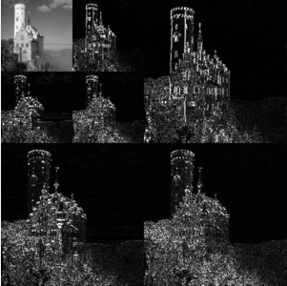
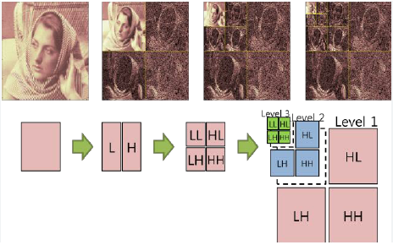
2D-DWT – Examples

Slide 28
Wavelet Transform – Merits and Demerits
Merits
Demerits
Multiresolution Analysis
Localization in Time and Frequency
Adaptability to Signal Characteristics
Sparse Representation
Energy Compression
Edge Detection and Feature Extraction
Applications in Image Processing
Real-Time Processing
Shift Variance
Boundary Effects
Complexity of Implementation
Selection of Wavelet Basis
Limited Directionality
Loss of Phase Information
Trade-Off in Time and Frequency Resolution

Slide 29
Parametric Transformation
Geometric Transformations:
Euclidean/Rigid Transform:
Rotation
Translation
Similarity Transform:
Scaling
Scaled Rotation
Affine Transformation
Perspective/Projective Transform

Slide 30
Mesh-based Warping
Also known as mesh warping or grid warping
Used to deform or distort an image by manipulating a mesh or grid overlaying the original image.
Goal:
Achieve non-rigid transformations that can be applied to specific regions of an image while leaving other regions unchanged.
Often employed in computer graphics, image registration, and computer vision applications.
Basic idea:
Defining a set of control points on a regular grid overlaid onto the image.
Each control point is associated with a corresponding point in the transformed image.
By adjusting the positions of these control points, the image is deformed or warped accordingly.
The transformation can be linear or non-linear, allowing for flexible manipulation of the image.

Slide 31
Key steps in Mesh warping
Grid Initialization:
Overlay a regular grid on the original image (typically defined by rows and columns of control points).
Control Point Placement:
Place control points at key locations on the grid
These points serve as the anchors for the deformation.
The number and arrangement of control points can vary based on the application.
Define Correspondences:
Associate each control point in the original grid with a corresponding point in the transformed image.
This establishes a correspondence/link between the control points of the original and transformed images.
Adjust Control Point Positions:
Modify the positions of the control points to achieve the desired deformation.
The movement of control points affects the surrounding pixels, resulting in a non-rigid transformation.
Interpolation:
Interpolate pixel values between control points to fill in the transformed image.

Slide 32
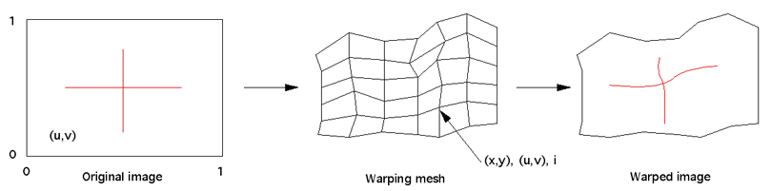
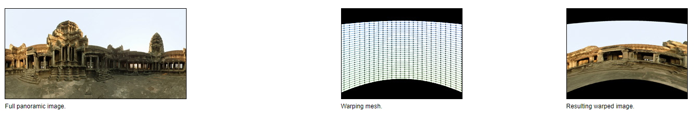
Mesh Warping – Example

Slide 33
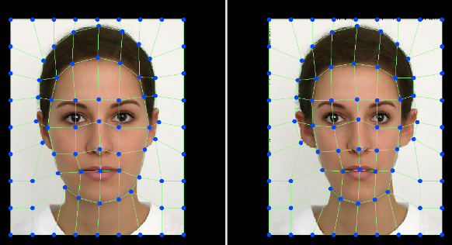
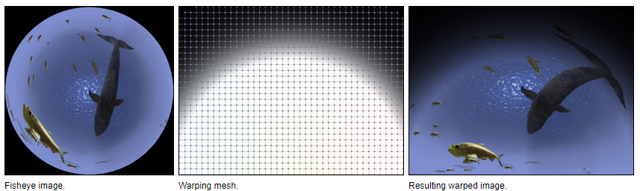
Mesh Warping – example

